Slide 1
Poisson Distribution
Eric Scott

Slide 2
Announcements
Exam 1 on Thurs Feb 27
Old exams posted on Canvas
Scope will be what we get through today (i.e. expect at least one Poisson question)
No lecture Thursday, yes lab Thursday
Review session Wednesday the 26th ?
Morning or 4:30 – 6:00?
Homeworks are graded, will upload solutions after class
Distinguish between MLE and likelihood

Slide 3
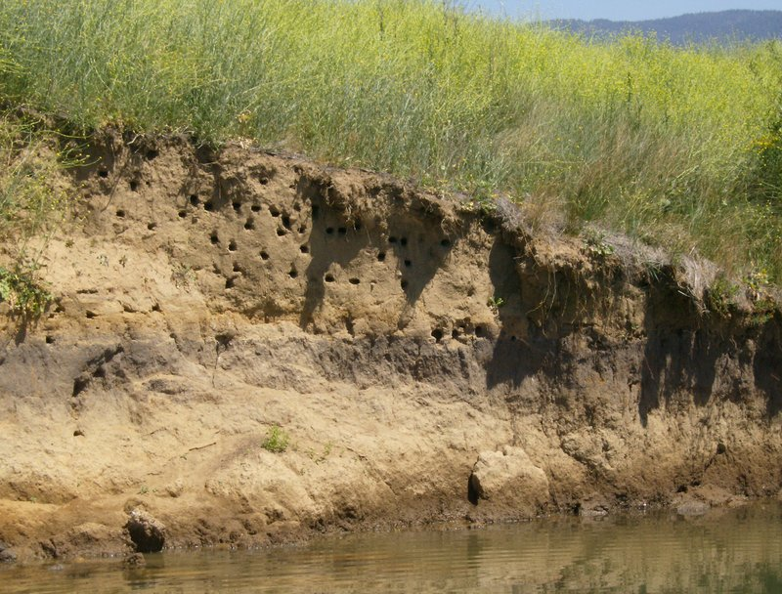
Bank Swallows
I misinterpreted the data!
A “colony” is an entire area with many burrows. Colonies can be 10s – 1000s of individuals.
An “extinct” colony is an area of river bank that becomes completely uninhabited the following year.
Go through analysis from last time in R

Slide 4
Poisson Distribution

Slide 5
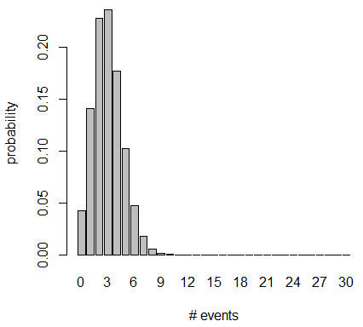
Binomial distribution # Events out of fixed number of trials
N = # trials [dependent variable]
k = # events [dependent variable]
p = probability of event in 1 trial
[parameter we are estimating]
E[k] = μ = Np
Var[k] = σ² = Np(1-p)
Min value of k = 0, max = N
Min value of p = 0, max = 1

Slide 6
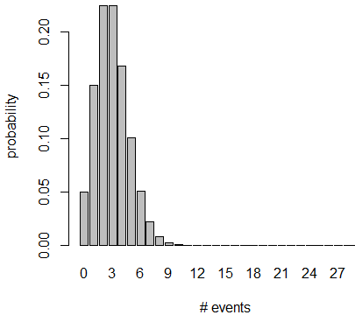
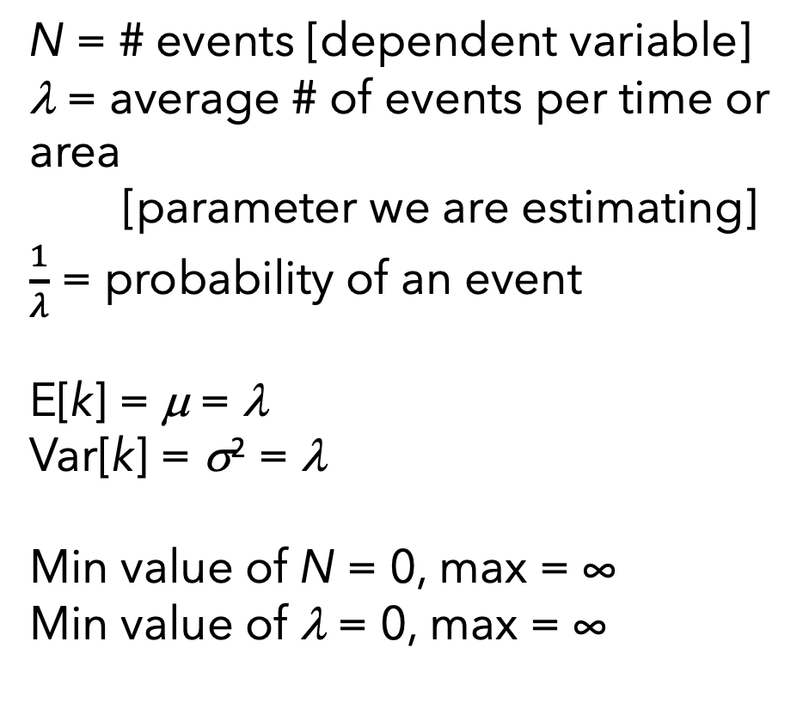
Poisson distribution # Events over given area in space or time
N = # events [dependent variable]
λ = average # of events per time or area
[parameter we are estimating]
$\frac{1}{λ}$ = probability of an event
E[k] = μ = λ
Var[k] = σ² = λ
Min value of N = 0, max = ∞
Min value of λ = 0, max = ∞

Slide 7
Binomial | Poisson
Describes # of events | Describes # of events
Out of a number of trials | Over a period of time or area in space
# of events bounded at 0 and # of trials | # of events bounded at 0 and ∞
Defined by probability per event, p, bounded at 0 and 1 | Defined by rate parameter, λ, expected # of events per time (or space) bounded at 0 and ∞
Mean = Np | Mean = λ
Variance = Np(1-p) | Variance = λ
ASSUMPTION: All trials have the same probability of an event | ASSUMPTION: probability of an event does not vary in space or time
Link function: logit | Link function: log

Slide 8
Binomial | Poisson
Describes # of events | Describes # of events
Out of a number of trials | Over a period of time or area in space
# of events bounded at 0 and # of trials | # of events bounded at 0 and ∞
Defined by probability per event, p, bounded at 0 and 1 | Defined by rate parameter, λ, expected # of events per time (or space) bounded at 0 and ∞
Mean = Np | Mean = λ
Variance = Np(1-p) | Variance = λ
ASSUMPTION: All trials have the same probability of an event | ASSUMPTION: probability of an event does not vary in space or time
Link function: logit | Link function: log
*If you have a number of events, but you’re not sure how many “trials” there are, your data are probably Poisson distributed

Slide 9
Binomial | Poisson
Describes # of events | Describes # of events
Out of a number of trials | Over a period of time or area in space
# of events bounded at 0 and # of trials | # of events bounded at 0 and ∞
Defined by probability per event, p, bounded at 0 and 1 | Defined by rate parameter, λ, expected # of events per time (or space) bounded at 0 and ∞
Mean = Np | Mean = λ
Variance = Np(1-p) | Variance = λ
ASSUMPTION: All trials have the same probability of an event | ASSUMPTION: probability of an event does not vary in space or time
Link function: logit | Link function: log
*Parameters estimated from the data

Slide 10
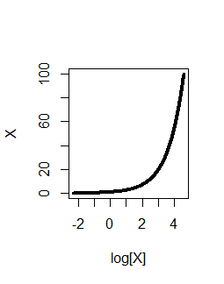
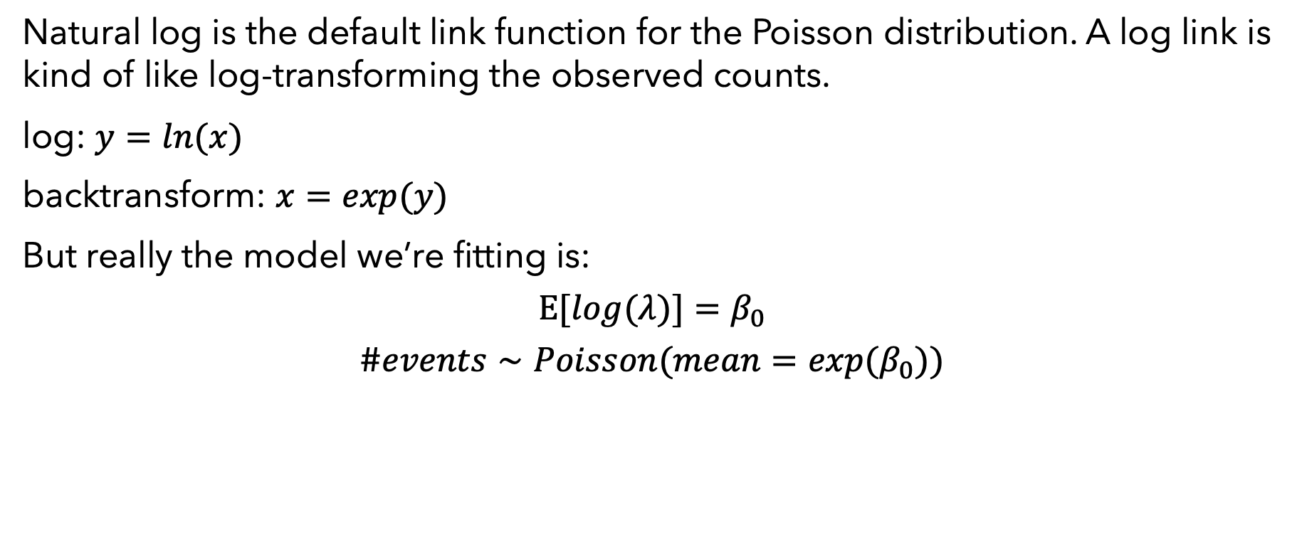
Log link
Natural log is the default link function for the Poisson distribution. A log link is kind of like log-transforming the observed counts.
log: $y=ln(x)$
backtransform: $x=exp(y)$
But really the model we’re fitting is:
$$E[log(λ)]=β_{0}$$
$$\#events∼Poisson(mean=exp(β_{0}))$$
average # of events per sampling unit
Back-transformed model coefficient
=

Slide 11
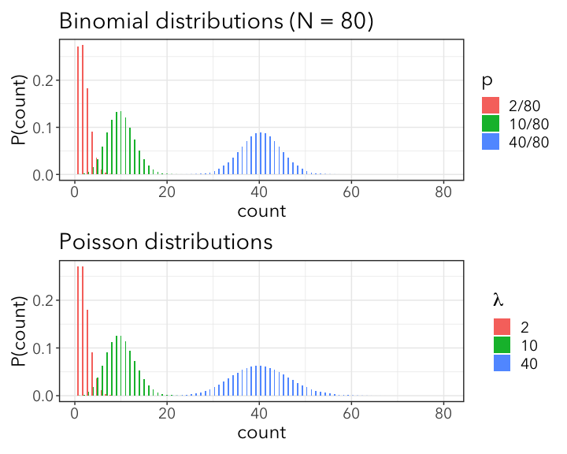

Binomial and Poisson
The binomial distribution approaches the Poisson distribution as $N→∞$ and $p=\frac{λ}{N}$

Slide 12
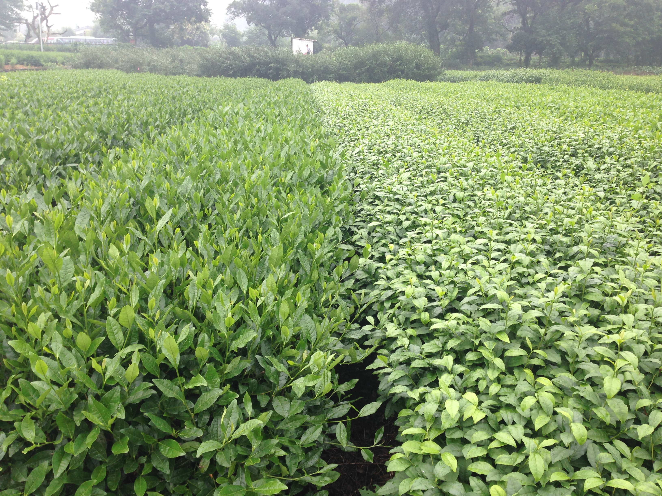
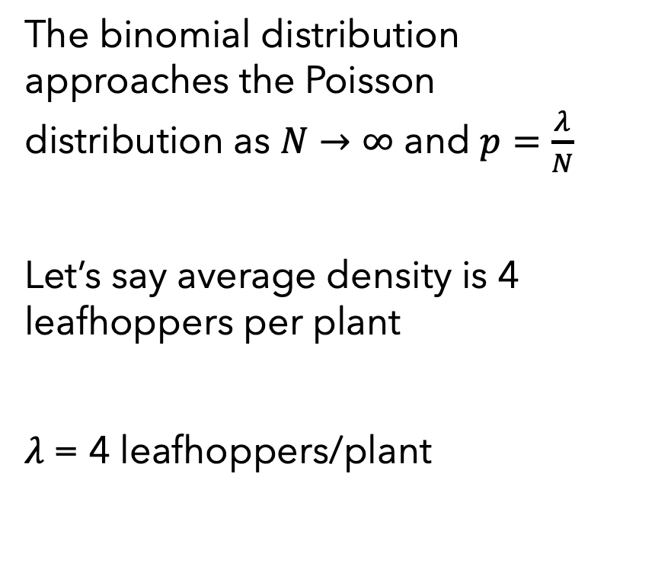
Binomial and Poisson
The binomial distribution approaches the Poisson distribution as $N→∞$ and $p=\frac{λ}{N}$
Let’s say average density is 4 leafhoppers per plant
𝜆 = 4 leafhoppers/plant

Slide 13
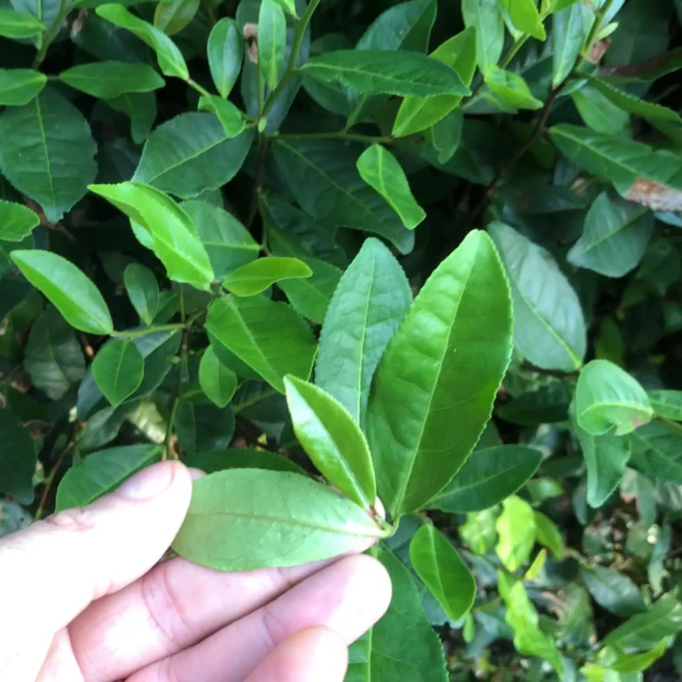
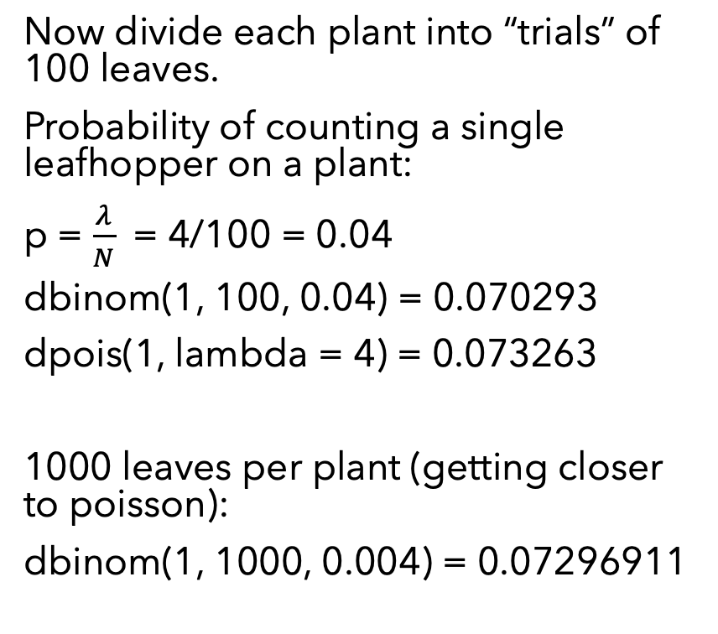
Binomial and Poisson
Now divide each plant into “trials” of 100 leaves.
Probability of counting a single leafhopper on a plant:
p = $\frac{λ}{N}$ = 4/100 = 0.04
dbinom(1, 100, 0.04) = 0.070293
dpois(1, lambda = 4) = 0.073263
1000 leaves per plant (getting closer to poisson):
dbinom(1, 1000, 0.004) = 0.07296911

Slide 14
A Poisson GLM
Let’s return to the bank swallows, but instead of modeling extinctions, let’s just ask if the total number of colonies has changed.
birds <- read_csv(here("data", "BankSwallows.csv")) head(birds)
## # A tibble: 6 x 4 ## year period num_colonies num_extinct ## <dbl> <chr> <dbl> <dbl> ## 1 1986 early 53 19 ## 2 1987 early 49 35 ## 3 1988 early 30 11 ## 4 1989 early 23 11 ## 5 1990 early 30 12 ## 6 1991 early 36 11

Slide 15
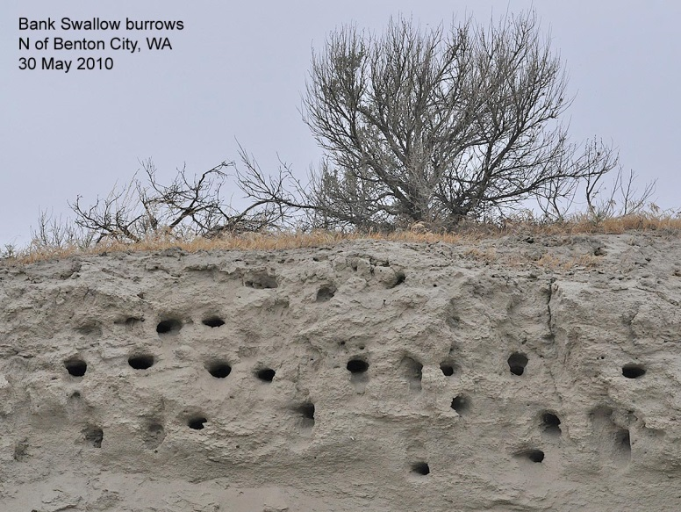
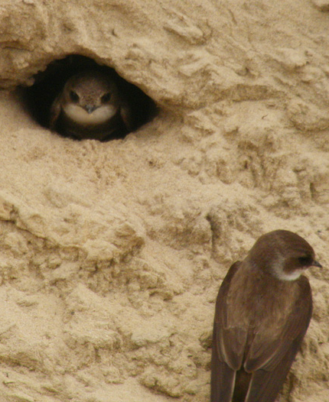
year | # occupied colonies | # that went "extinct" (were not occupied in the next year)
1986 | 53 | 19
1987 | 49 | 35
1988 | 30 | 11
1989 | 23 | 11
1990 | 30 | 12
1991 | 36 | 11
1996 | 42 | 32
1997 | 40 | 24
1998 | 38 | 34
1999 | 47 | 41
2000 | 33 | 16
2001 | 38 | 19
2002 | 44 | 35
Use the “BankSwallows.csv” dataset on Canvas
Example 1: First use math, then use a GLM…
What is the mean number of occupied colonies?
What is the mean number of occupied colonies in the early (1986-1991) vs. later (1996-2002) years?
What is the mean number of occupied colonies/year?
Notes:
Why Poisson not Binomial? (Colonies for the length of river sampled. No defined “trials”)
What is the mean number of colonies?
Does it differ by year?

Slide 16
Example 1: bank swallows, Poisson GLM
Model 1: mean number of colonies
m1 <- glm(num_colonies ~ 1, family = poisson(link = "log"), data = birds) coef(m1)
## (Intercept) ## 3.655641
exp(coef(m1))
## (Intercept) ## 38.69231
This is just the mean number of colonies
mean(birds$num_colonies)
## [1] 38.69231

Slide 17
Example 1: bank swallows, Poisson GLM
Model 2: different means for early vs. late
m2 <- glm(num_colonies ~ -1 + period, family = poisson, data = birds) coef(m2)
## periodearly periodlate ## 3.606403 3.695997
exp(coef(m2))
## periodearly periodlate ## 36.83333 40.28571

Slide 18
Example 1: bank swallows, Poisson GLM
Model 2: different means for early vs. late
Compare to means estimated from raw data:
birds %>% group_by(period) %>% summarize(mean_colonies = mean(num_colonies))
## # A tibble: 2 x 2 ## period mean_colonies ## <chr> <dbl> ## 1 early 36.8 ## 2 late 40.3
No difference between early and late.

Slide 19
Example 1: bank swallows, Poisson GLM
Model 2: different means for early vs. late
lrtest(m1, m2)
## Likelihood ratio test ## ## Model 1: num_colonies ~ 1 ## Model 2: num_colonies ~ -1 + period ## #Df LogLik Df Chisq Pr(>Chisq) ## 1 1 -46.956 ## 2 2 -46.457 1 0.9978 0.3178
No difference between early and late.

Slide 20
Example 1: bank swallows, Poisson GLM
Model 3: mean number of colonies by year
m3 <- glm(num_colonies ~ -1 + as.factor(year), family = poisson, data = birds) exp(coef(m3))
## as.factor(year)1986 as.factor(year)1987 as.factor(year)1988 ## 53 49 30 ## as.factor(year)1989 as.factor(year)1990 as.factor(year)1991 ## 23 30 36 ## as.factor(year)1996 as.factor(year)1997 as.factor(year)1998 ## 42 40 38 ## as.factor(year)1999 as.factor(year)2000 as.factor(year)2001 ## 47 33 38 ## as.factor(year)2002 ## 44
This just gives us back our original data since there is only 1 row per year!

Slide 21
Example 1: bank swallows, Poisson GLM
Model 4: trend through time
m4 <- glm(num_colonies ~ year, family = poisson, data = birds) coef(m4)
## (Intercept) year ## -1.43041009 0.00255043
Intercept and slope on log-scale
bbmle::ICtab(m1, m2, m3, m4)
## dAIC df ## m1 0.0 1 ## m2 1.0 2 ## m3 1.3 13 ## m4 1.9 2
Model 1 “wins”, but all other models can’t be discarded because they are within 2 dAIC of the winner.

Slide 22
Example 2
Counts of butterfly eggs per 1m² plot (uniform sampling effort)
Notes:
Why Poisson not Binomial?

Slide 23
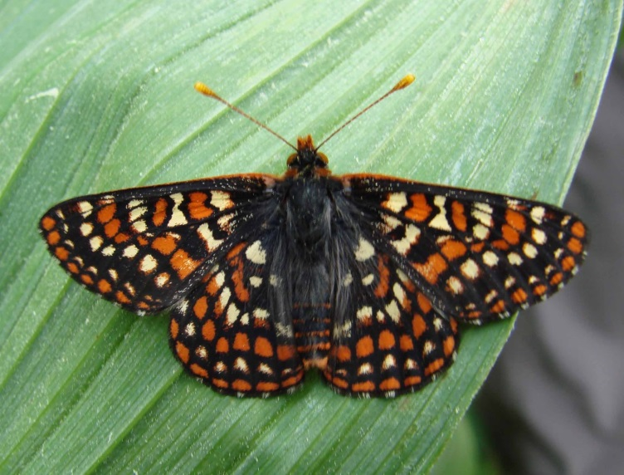
Example 2: Counts of butterfly eggs per 1-m² plot
(uniform sampling effort)
How many eggs were found in 2010 in plots where herbicide was used versus no herbicide was used?
Use a likelihood ratio test to compare the model above to a null model in which there is no effect of treatment on the number of eggs counted in 2010.
Use the “butterfly_herbicides.csv” dataset on Canvas:
Taylor’s checkerspot (Euphydryas editha taylori)
Notes:
Herbicide used to kill grasses that crowd out host plants

Slide 24
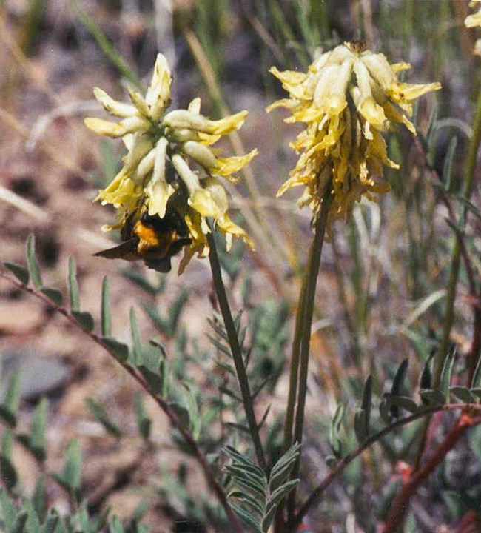
Example 3: Number of bees that visit individual plants, based on a different number of hours of observation
year | # bees seen | # hours watching plants | bees/hour
1999 | 6 | 12 | 0.50
2000 | 20 | 38 | 0.53
2001 | 39 | 48 | 0.81
2002 | 62 | 46 | 1.35
2004 | 41 | 46.5 | 0.88
2005 | 28 | 31.5 | 0.89
2006 | 127 | 55 | 2.31
2007 | 58 | 60 | 0.97
Number of bees/hour is rate…

Slide 25

Example 3: Number of bees that visit individual plants, based on a different number of hours of observation
Number of bees/hour is rate
Why not analyze as a ratio?
Loose information
Why not divide into 1-hour periods?
“period” is an arbitrary decision (1-hour? 30 min? 10 min?)
Solution: “offsets” → bees/hour = B/H
ln(B/H) = β₀
ln(B) – ln(H) = β₀
ln(B) = β₀ + ln(H)
Offset!

Slide 26
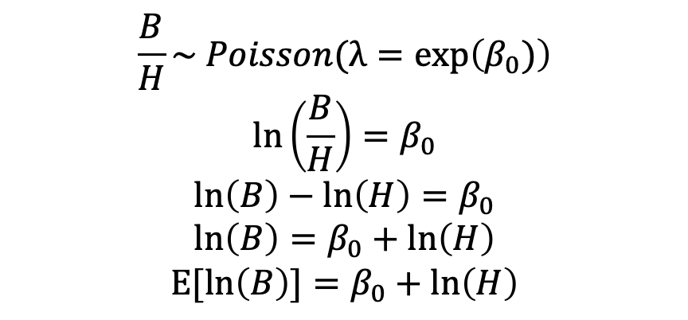

Example 3: Number of bees that visit individual plants, based on a different number of hours of observation
year | # bees seen | # hours watching plants | bees/hour
1999 | 6 | 12 | 0.50
2000 | 20 | 38 | 0.53
2001 | 39 | 48 | 0.81
2002 | 62 | 46 | 1.35
2004 | 41 | 46.5 | 0.88
2005 | 28 | 31.5 | 0.89
2006 | 127 | 55 | 2.31
2007 | 58 | 60 | 0.97
$$\frac{B}{H}\sim Poisson(λ=exp\left(β_{0})\right)$$
$$ln\left(\frac{B}{H}\right)=β_{0}$$
$$ln\left(B\right)−ln\left(H\right)=β_{0}$$
$$ln\left(B\right)=β_{0}+ln\left(H\right)$$
$$E[ln\left(B\right)]=β_{0}+ln\left(H\right)$$
B = # bees
H = # hours of observation
Poisson family, with log link
glm(B ~ 1, offset = log(H), family = poisson, …)

Slide 27
Example 3: Number of bees that visit individual plants, based on a different number of hours of observation
Use the “BeeVisits.csv” dataset on Canvas:
Calculate the average number of bees visiting plants per hour using a Poisson model with an offset
Compare this to an estimate of the mean number of visits/hour from the raw data
Use a likelihood ratio test to compare the GLM above to a model in which bee visitation differs among sites
year | # bees seen | # hours watching plants | bees/hour
1999 | 6 | 12 | 0.50
2000 | 20 | 38 | 0.53
2001 | 39 | 48 | 0.81
2002 | 62 | 46 | 1.35
2004 | 41 | 46.5 | 0.88
2005 | 28 | 31.5 | 0.89
2006 | 127 | 55 | 2.31
2007 | 58 | 60 | 0.97

Slide 28
Example 3 Code
Poisson family, log-link model with an offset. This model estimates the ratio of the response variable to the offset variable, in this case bees per hour of observation.
bees <- read_csv(here("data", "BeeVisits.csv"))
m.bees <- glm(Bees ~ 1, offset = log(Hours), family = poisson, data = bees) coef(m.bees) #ratio on a log scale
## (Intercept) ## 0.1227164
exp(coef(m.bees)) #back-transformed ratio
## (Intercept) ## 1.130564
Confidence intervals:
exp(confint(m.bees))
## Waiting for profiling to be done...
## 2.5 % 97.5 % ## 1.020806 1.247914
About 1.13 bees per observation hour across the whole dataset

Slide 29
Do bee visitation rates differ among sites?
m.sites <- glm(Bees ~ -1 + Site, offset = log(Hours), family = poisson, data = bees) library(lmtest) lrtest(m.bees, m.sites) #likelihood ratio test
## Likelihood ratio test ## ## Model 1: Bees ~ 1 ## Model 2: Bees ~ -1 + Site ## #Df LogLik Df Chisq Pr(>Chisq) ## 1 1 -117.345 ## 2 5 -96.828 4 41.034 2.644e-08 *** ## --- ## Signif. codes: 0 '***' 0.001 '**' 0.01 '*' 0.05 '.' 0.1 ' ' 1
Yes, sites differ significantly in their rate of bee visitation

Slide 30
Do bee visitation rates differ among sites?
How do the sites differ from eachother?
exp(coef(m.sites))
## SiteAgency SiteHayden SiteHaynes SiteReservoir SiteSheep ## 0.8750000 1.0000000 0.8800000 1.6111111 0.7802691
Reservoir has the highest visitation rates, but are they significantly different than the other sites?
exp(confint(m.sites))
## Waiting for profiling to be done...
## 2.5 % 97.5 % ## SiteAgency 0.5896057 1.2402649 ## SiteHayden 0.6834962 1.4017128 ## SiteHaynes 0.6128779 1.2153038 ## SiteReservoir 1.3995206 1.8430086 ## SiteSheep 0.6275846 0.9559008
The 95% CI for Reservoir overlaps the Hayden site, but the bee visitation rate for Reservoir is significantly higher than all the other sites.

Slide 31
Plotting CIs
Some example code at how you might plot the confidence intervals for each level of a factor
beeplotdf <- exp(confint(m.sites)) %>% as_tibble(rownames = "site") %>% #convert to a data frame mutate(site = str_remove(site, "Site")) %>% #clean up site names rename(lower = `2.5 %`, upper = `97.5 %`) %>% #clean up column names add_column(mean = exp(coef(m.sites))) #add column for coefficients
#plot:
ggplot(beeplotdf, aes(x = site, y = mean)) + geom_point(shape = "square", size = 3) + #plot mean rates geom_errorbar(aes(ymin = lower, ymax = upper, width = 0.2)) + #add bars for CI labs(x = "Site", y = "Bee visitation rate (bees/hour)") + ylim(0,2)

Slide 32
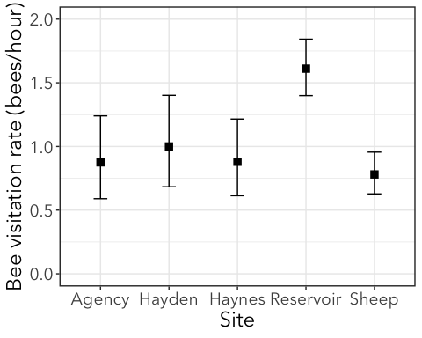

Slide 33
Poisson Review
Poisson distribution describes probability for count data
Use Poisson when data is counts, but no definition of a “trial”
Counts can also be rates (# leafhoppers per plant, bees/hr, eggs/m²
If area or time is not uniform across all the samples, correct for this with an offset glm(response ~ 1, offset = log(effort)…)
Offset must be on the same scale as response! I.e., if you use log-link, then it must be log(hours) or log(area)!
Same as binomial, coeficients and confidence intervals must be back-transformed to interpret
exp() is the inverse of log()
Do calculations (e.g. predict(), confint()) FIRST, then back-transform

